Slide 1
STUDENT NAME:M C SANGEETHA
REGISTRATION NUMBER:30324U18109
DEPARTMENT:B.SC COMPUTER SCIENCE
YEAR:II YEAR
COLLEGE:ARCOT SRI MAHALAKSHMI WOMEN’S COLLEGE

Slide 2
DIGITAL PORTFOLIO

Slide 3
INDEX
Problem statement
Project overview
End user
Tools and technologies
Portfolio design and layout
Features and functionaries
Result and screen shot
Conclusion

Slide 4
PROBLEM STATEMENT
A digital portfolio is a online collection of one’s best work , achievements and experiences , which allows potential employers , clients, or collaborators to gain a comprehensive understanding of one’s capabilities.
Creating a digital portfolio is essential for showcasing one’s skills and accomplishments in the modern job market.
It helps us to stand out from the competition .
An online portfolio helps in increasing the chances of being found by recruiters and clients through search engines and social media.

Slide 5
PROJECT OVERVIEW
The digital portfolio has a well organized online collection of the best work ,accompanied by a professional bio data or About me section , contact information like e-mail address and other testimonials skills like Credly badge , online credentials .
The digital portfolio also contains different color background with different shades in different font styles.
This online portfolio has been made using HTML for structuring the page , CSS for styling the sheet and finally the Java script for creating the page responsive.
It was created has a simple resume profile of college students.

Slide 6
END USER
The digital portfolio is created in a dynamic rather than a traditional resume content or in a static way.
This portfolio contains a peer or instructor feedback section.
It has been created in the formal academic record way with some small extra features.
The portfolio contains all the information like contacts , education qualifications , with some extra interested topics.
It can be Used for resumes, Academic projects and for future Used.

Slide 7
TOOLS AND TECHNOLOGIES
Websites builders and presentation software like Google sites , canva for inspiration of online portfolio , Code pen for writing the codes that created .
Specialized digital portfolio and content creation tools like book creator for inspiration of the codes .
A Google Doc provides an helps to write and reflect on each artifact or topics of learning of the coding.
The artifacts ,images or any other needed content can be stored in a Google Drive Folder which helps in directly with the coding.
Website creating Languages like HTML,CSS,JS were used.

Slide 8

HTML
Hypertext markup language is the standard markup language used to create and structure content for web pages. It uses tags to define elements like headings, paragraphs, images, and links, which a web browser then interprets to display content as a web page.

Slide 9
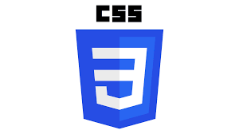
css
CSS stands for Cascading Style Sheets. It is a language used to describe the presentation and styling of web pages written in HTML or XML, including elements like colors, layouts, and fonts.
Key aspects of CSS:
Separation of Concerns
Styling Capabilities
Efficiency

Slide 10

js
Js=JAVA SCRIPT
It is used to build interactive websites and applications.
It can create dynamic features like animations , interactive forms and content updates with reloading the page.

Slide 11
PORTFOLIO DESIGN AND LAYOUT
Home section or the About me section in which the bio-data like my name, logo, profile.
The portfolio created is responsive and have a good flexible on desktop, tablets and smartphones.
It also contains curriculum vitae in depth document containing the academic education,skills,accomplishments.
At last it has contact information like email address ,telegram id or phone number.
Notes:
ede

Slide 12
FEATURES AND FUNCTIONARIES
FEATURES
FUNCTIONARIES
Media and content flexibility
Student ownership
Reflection tool
Editing and organization
Customization and templates
Interactive elements
Contact form with validation
Demonstrating growth and skills
Facilitating communication and feedback
Showcasing achievements
Aiding assessment and evaluation
Navigation bar with smooth scrolling.

Slide 13
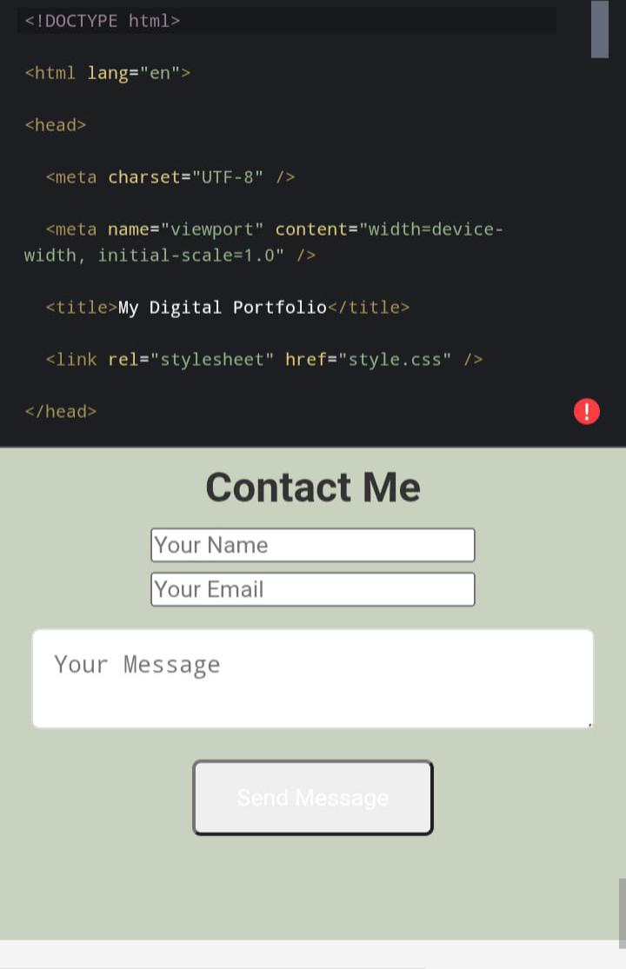
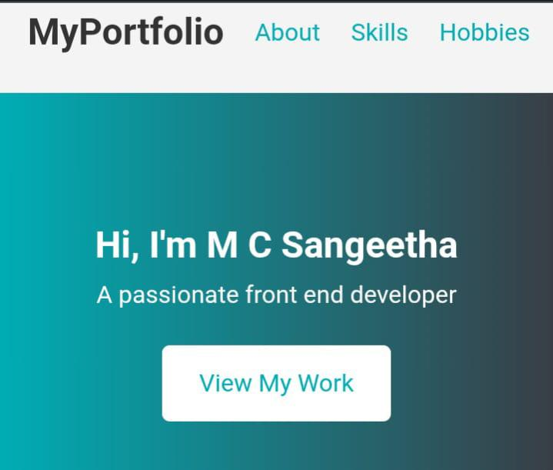
RESULT AND SCREEN SHOT

Slide 14
CONCLUSION
Digital portfolios –as repositories of evidence of learning and growth –can be used in multiple ways.
They are a useful tool for students to reflect on their own personal growth over the course of the year.
This can be as simple as inviting the audiences to connect , asking for feedback or encouraging them to explore more.

Slide 15
GITHUB LINK
Link:https://github.com/mcsangeetha440-wq/TNSDC-FWD-DP1.git.

